Slide 1
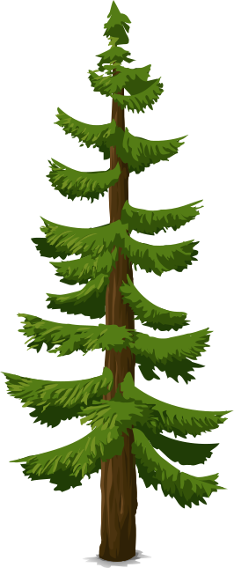
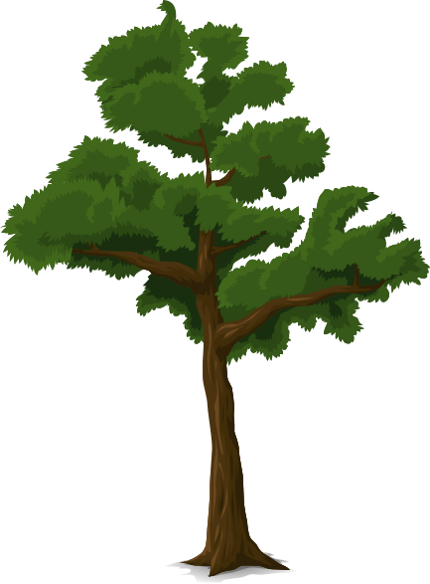

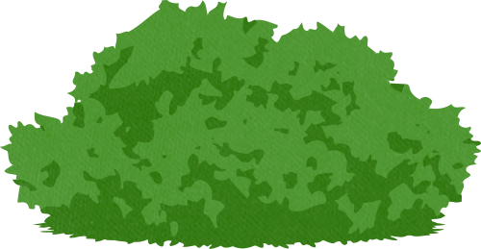
Ecosystem
Preserve
Senior Project
Davis Addink, Felicia Susanto, Sucry Bendeck

Slide 2

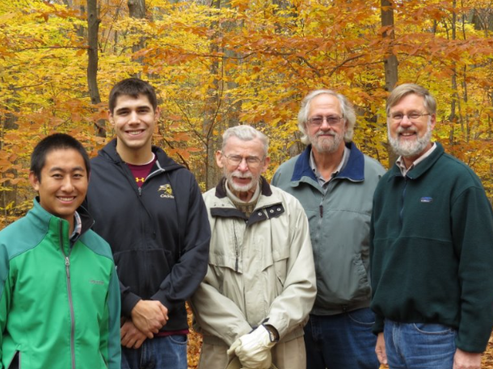

History
1974
43 Quadrats
7 Quadrats added in 1994 expansion
Notes:
Randy Van Dragt
This project has benefited from Calvin faculty and students’ contributions. They collect data as Preserve Stewards, ensuring the dataset remains updated and accurate. Their efforts include measuring DBH, mapping tree coordinates, and identifying species, which is vital to understanding forest changes.

Slide 3
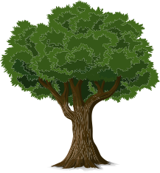
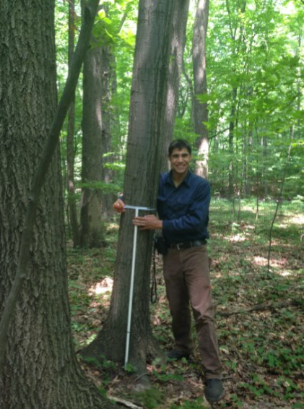
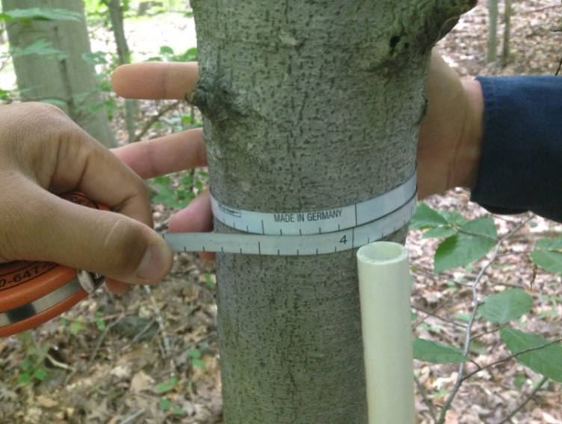

Measuring Diameter at Breast Height (DBH)
Notes:
A number of variables were measured every 5 years, including:
Species
DBH, only if it is greater than 4in because those are considered trees in forest ecology
Size Class
Living
DBH were measured at 1.3 and 1.5m but the difference was not statistically significant.
Stems were categorized into two size ranges:
2–3.9 inches DBH.
4.0 inches or larger DBH (classified as "trees" in forest ecology).
The 4.0 inches or larger group has been regularly monitored since.
Each tree is mapped with GPS coordinates, and they’ve summarized information at tree, quadrat, and edge-versus-core levels. This includes tree size, species richness, diversity, and density

Slide 4
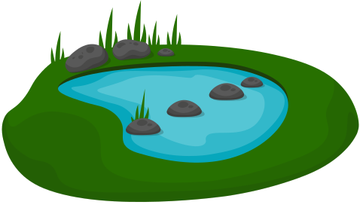
Growing Degree Days (GDD)
Measures length and intensity of the growing season
GDD = (Tmax + Tmin) / 2 - 50
Tmax = maximum temp on a given day
Tmin = minimum temp on a given day
50 - standard base temp for given location (MI is 50º F)
Cannot be negative - defaults to zero
Builds on previous days in the year to give a cumulative yearly value
Notes:
Switch to other window with spatial plot

Slide 5
Shannon Diversity Index
Measures tree species diversity near each measured tree
H = -Σp_{i} * ln(p_{i})
H = diversity score: 1.5 - 2.25 is normal
p_{i}: proportion of a species in a set area
Notes:
Switch to other window with spatial plot

Slide 6
Other Added Variables
Cumulative Precipitation
Nearest Tree Distance
Lidar
Notes:
Switch to other window with spatial plot

Slide 7
Exploratory Data Analysis Visualizations
Spatial
Lidar
GDD
DBH
Notes:
Switch to other window with spatial plot

Slide 8
Data Modeling
We fit a big additive model to model tree growth rate as a function of:
Climate variables (GDD and Precipitation)
Lidar Data (Elevation Points)
Biodiversity (Shannon Diversity Index)
Neighbors (Distance to nearest tree)
Species specific effects of Tree Size (DBH)
Year (nonlinear)
Notes:
Weather and growth rate, we are working on it, getting close Our goal is to model the data by analyzing tree growth in relation to surrounding species, location, weather, and LIDAR-derived elevation points. (Switch to other LIDAR window)
Planning to merge the plots and maps
This gives us a holistic understanding of the factors shaping the forest. Additionally, we’re aiming to create interactive visualizations to share these findings online, allowing broader engagement with the preserve’s story

Slide 9
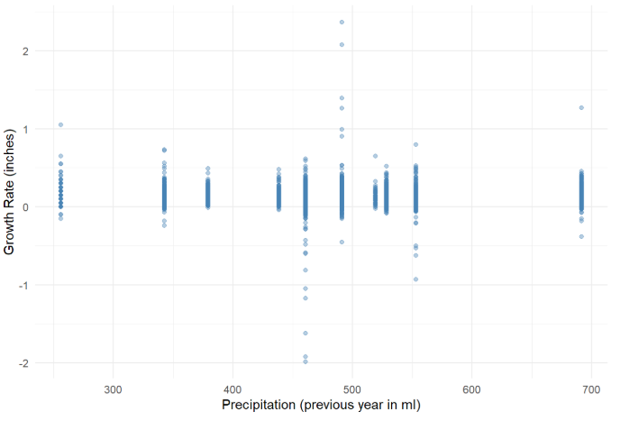
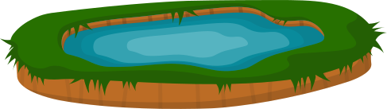

Slide 10
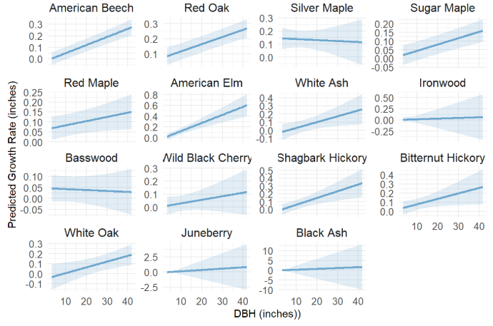

Slide 11
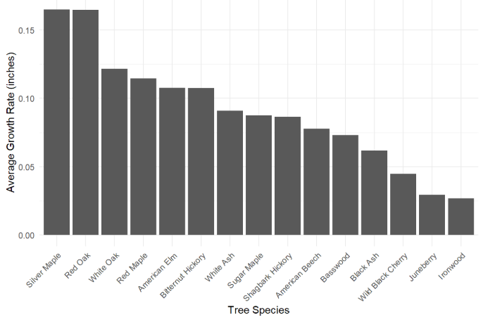

Slide 12
Design Norms
Stewardship
Caring
Transparency
Notes:
Weather and growth rate, we are working on it, getting close Our goal is to model the data by analyzing tree growth in relation to surrounding species, location, weather, and LIDAR-derived elevation points. (Switch to other LIDAR window)
Planning to merge the plots and maps
This gives us a holistic understanding of the factors shaping the forest. Additionally, we’re aiming to create interactive visualizations to share these findings online, allowing broader engagement with the preserve’s story

Slide 13
Future Work
Public website
Ecosystem Preserve event
Tree canopy variable
Additional modeling of DBH measurement error
Notes:
Weather and growth rate, we are working on it, getting close Our goal is to model the data by analyzing tree growth in relation to surrounding species, location, weather, and LIDAR-derived elevation points. (Switch to other LIDAR window)
Planning to merge the plots and maps
This gives us a holistic understanding of the factors shaping the forest. Additionally, we’re aiming to create interactive visualizations to share these findings online, allowing broader engagement with the preserve’s story

Slide 14
Questions

